Slide 1

Flight Delay Prediction- A Comparative Analysis Using ML Algorithms
BY- Priyanshu Pandey

Slide 2
INTRODUCTION
A flight is said to be delayed when it arrives 15 or more minutes later than the schedule.
Flight delays cause a lot of inconvenience to passengers.
The aviation industry around the globe incurs huge losses due to various factors, one of these factors is Airline Delay.
Airline delay tends to be onerous for each entity involved i.e. airports, airlines and passengers.
Precise and meticulous prediction of Airline delay using the factors which play prodigious role are going to be the key to attenuate the losses and increase customer satisfaction.

Slide 3
ABSTRACT
In the paper, several machine learning algorithms have been employed to produce a comparative study with respect to the accuracy of each algorithm.
The Flight Delay Prediction System consists of : Data Pre-processing, Data Visualization, Feature Selection and Data Balancing.
In this model, many formulas are utilized to provide a comparative study with relation to the accuracy of every algorithm. Machine learning is additionally capable of mechanically extracting the vital options from large volumes of knowledge.
The preciseness, accuracy, recall and F-measure of the varied algorithms applied on the extracted and processed data is measured to match the results.
The results additionally showcase the accuracy of the projected model depicting the precision of each algorithm in order to draw a comparative study of their respective outputs.

Slide 4
OBJECTIVE
To compare the accuracies of different machine learning algorithms based on a predetermined data set.
To create a highly accurate model for flight delay prediction using different ML and deep learning algorithms.
To form the basis of future research work which could be implemented in real time.
Reduction of the magnitude of Air Traffic congestion that may add to the delay of flights.
To determine how different combinations of feature selections affect the accuracy of the model.

Slide 5
EXISTING SYSTEMS
Some of the existing systems to predict flight delays include:
Flight Delay Prediction using Machine Learning which employ various ML algorithms such as SVM, Random Forest and Naïve Bayes to train and test datasets from individual flights based on certain features.
Airline Delay prediction using Machine Learning and Deep Learning in which important characteristics are extracted from dataset for both neural and deep belief networks through arbitrary samples to train the model. Algorithms used were Ada Boost and KN neighbors.

Slide 6
Flight Arrival Delay Prediction using Machine Learning and Gradient Boosting Classifier for predicting arrival delays of flights by employing the LightGBM technique of machine learning where feature selection is not considered as an important aspect.
Flight Delay Prediction using Data Mining and Big Data Approach in order to analyze and mine the flight information as well as its corresponding weather information using parallel algorithms with the help of MapReduce programs executed on cloud platforms for weather induced delays.

Slide 7
ISSUES IN EXISTING SYSTEMS
Flight delay predictions were made based on only weather conditions and other unprecedented events such as major calamities, natural or man-made were not considered.
The scope of certain systems were limited to departure delays for the primary New York airports and hence these systems were not applicable to other airports in the USA, let alone other countries.
In some systems, the impact of the variables on a high delay level or of a higher ranking is presented. So the variables that have a rather lower level of significance ranking in terms of flight delays were not considered.

Slide 8
Contd…
Datasets collected for some systems were only limited to US domestic flights and hence prediction of flight delays could only be obtained for the same.
Inability to inform the passengers about the delays of flight by employment of certain systems made them less desirable as compared to others.
Feature Selection in most models wasn’t considered important and majority systems made their predictions based on limited reasons such as weather conditions or arrival/ departure delays and hance the predictions weren’t accurate.

Slide 9
PROBLEM DEFINITION
Flight delays are inevitable and play a vital role in the benefits and losses of aircraft.
Accurate measurement of flight delays is important for airlines because the results can be used to increase customer satisfaction and revenue for airlines.
There has been a lot of research on modeling and predicting flight delays, with most of them trying to predict delays by extracting important features and closely related features.
However, most of the proposed methods are not accurate enough due to the large volume data, dependence and excess number of parameters.

Slide 10
Contd…
We intend to propose a model for predicting flight delay based on Machine Learning. ML is one of the burgeoning methods employed in solving problems with high level of complexity and massive amount of data.
We will be using some important features from the dataset, which would be selected through feature selection algorithms. With the help of the selected features, an appropriate model will be created to predict the delay of aircrafts.
We would be using algorithms such as KNN, Random Forest, SVM, Logistic Regression and Naive Bayes. Out of these, we will be selected any one which would give maximum accuracy and a passable precision score.

Slide 11
Data Set
The U.S. Department of Transportation's (DOT) Bureau of Transportation Statistics tracks the on-time performance of domestic flights operated by large air carriers. Summary information on the number of on-time, delayed, canceled, and diverted flights is published in DOT's monthly Air Travel Consumer Report and in this dataset of 2015 flight delays and cancellations.
The data set contains flights that got delayed in the year 2015 from multiple airports across the USA. It contains columns like year, month, week, wheels off, wheels on and many more. The data set has been acquired from Kaggle. The link is attacked below:
https://www.kaggle.com/usdot/flight-delays?select=flights.csv

Slide 12
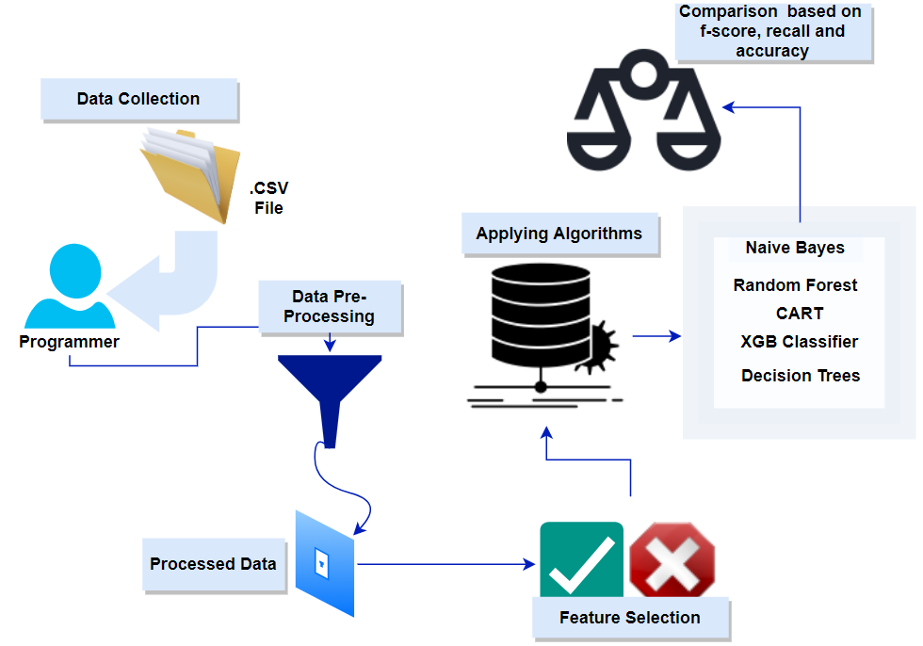
PROPOSED SYSTEM ARCHITECTURE
The basic system architecture can be understood with the help of the figures below:

Slide 13
PROPOSED SYSTEM WORK FLOW
The first step is Data Collection, the primary and the most crucial step towards building a model.
There are a few factors which are important while acquiring the dataset like the legitimacy, correctness and validity of the data.
The data used here is acquired from the Kaggle’s 2015 airline delay dataset .
Then comes the Data Preprocessing phase, here the data obtained is treated and changed into the desired format.

Slide 14
Contd…
Cleaning of data i.e. to remove the tuples have null values, checking for redundancies, dropping irrelevant details, etc. is carried out in this phase.
The processed data is then used for extracting features which are relevant and needed for training and testing phase.
The training and testing phase is carried out in each of the algorithms used. Then voting takes place where the values like f-score, recall, precision and accuracy of all the algorithms are compared.

Slide 15
MODULES AND THEIR EXPLANATION
Data Collection: The data we are talking about here is from Kaggle’s 2015 flight delay dataset. The dataset contains various columns like Year, Date, and Flight number, Delay time and many other columns which we call features. Once the dataset has been chosen that fulfils our requirement, we download the dataset in the form of .CSV file. We import this dataset into our Jupiter notebook.
Data Pre-processing: The next step is to clean the dataset and remove all the null values, check for redundancies and get rid of irrelevant details from it. After this step, we have clean data with which we can proceed with our project.

Slide 16
Contd…
Data Visualization: Sometimes data does not make sense until you can look at in a visual form, such as with charts and plots. In this step we represent the extracted data samples in the form of histograms and boxplots.
Feature Selection: In our project, we have used the Recursive Feature Elimination technique to get the important features for our project. The goal of a recursive feature elimination (RFE) is to select features by recursively considering the smaller sets of features. Out of the originally available 23 features only 16 were deemed as important for this project, thus the remaining were removed from the dataset.
Data Balancing: In order to ensure accuracy, several techniques such as oversampling/under sampling are performed to balance the given set of data. This helps in providing uniform distribution of that data and the same can be observed through heatmaps.

Slide 17
METHODS USED
The training and testing phase is carried using the algorithms mentioned below:
Classification and Regression Trees: In CART, the decision trees lay the input vectors to identify values in the leaves. The branches of the trees then split the input values based on the observation values. This process is repeated till we reach the leaves.
Naïve Bayes: Naive Bayes is a classification technique based on the assumption that the presence of a particular feature in a dataset is independent of other features. It makes it easier to predict the class of test dataset especially in cases where assumption of independence is true. In our project, the Naive Bayes algorithm calculates the probability of a flight getting delayed.

Slide 18
Contd…
XGB Classifier: XGBoost is an advanced implementation of a gradient boosting algorithm. It’s a highly sophisticated algorithm, so powerful that it can deal with all sorts of irregularities in the data. Parameter tuning is a must to improve the model.
Random Forrest: Random Forest is a classifier that contains multiple decision trees on various subsets of the given dataset and takes the average to improve the predictive accuracy of the model. In our case, the algorithm mixes different features and forms numerous trees. The average of all the accuracies from the trees is taken to display the final accuracy, and that’s how the algorithm works.
Decision Trees: Decision trees are a supervised type of learning algorithms in which the data is continuously split into decision nodes (where the data is split) and leaf nodes (which act as the outcomes) according to certain parameters.

Slide 19
IMPLEMENTATION PROCEDURE
The data set is downloaded and imported into the jupyter notebook.
Required number of samples are separated from the rest of the dataset.
Missing values are checked and removed from the dataset. Columns that are not required for the project are also dropped.
The datatype of the columns are checked. Accordingly the datatype of some columns are converted into the desired datatype.
Then data visualization is performed to check data distribution using various plots like box-plot, histogram, heatmap, distplot.
Feature importance of various features are checked out using a model and feature selection is performed over the dataset using recursive feature elimination process.
Data split is performed over the dataset. It splits the data into training and testing data.
Various ml models are implemented over the dataset and their results are noted.
Results are compared to vote out the best performing dataset.

Slide 20
TOOLS USED
Functional Requirements:
Jupyter Notebook
Python 3.8.2
Anaconda Navigator
Non Functional Requirements:
Transparency
Reliability
Performance
Scalability
Testability
Recoverability

Slide 21
RESULT
 | F1-score | Recall | Precision | Accuracy
Naive Bayes | 0.7096 | 0.7225 | 0.7056 | 98.65%
Decision Tree | 0.7213 | 0.7237 | 0.7209 | 98.90%
SVM | 0.0016 | 0.0056 | 0.0012 | 3.73%
CART | 0.7678 | 0.7714 | 0.7659 | 99.15%
Random Forest | 0.6367 | 0.6474 | 0.6455 | 97.24%
RF Classifier | 0.1458 | 0.1577 | 0.1493 | 63.76%
LGBM | 0.0020 | 0.0085 | 0.002 | 3.96%
Bagged Decision Tree | 0.7272 | 0.7346 | 0.7238 | 98.85%
XGB Classifier | 0.7052 | 0.7006 | 0.7173 | 98.50%

Slide 22
Conclusion
A successful comparative study resulted in CART yielding the highest accuracy amongst various machine learning algorithms.
Tree based ML algorithms gave out significantly high accuracies.
Relatively, larger datasets would also tend to give similar accuracies.
With appropriate user interface, these ML models can be implemented in real time to predict flight delays.
Airlines can cut their losses by a much larger extent. This may also help portray a positive reputation of the companies. This may also help reduce sustainability issues, and reduce fuel consumption and gas emissions.
This project may also help other researchers study delay analysis, based on real dataset provided in a much better way.

Slide 23
Thank You…

